Slide 1
Market Basket Analysis
Presented By: Farjana Kabir
Trainee Data Scientist position,
AnalyticsHacker.com, UK

Slide 2
Data Preprocessing(Data: data2_electronics)
Drop First 6 rows
drop all null values
using the positive quantity values
drop row where Transaction Id is missing
drop 'not set' column because of missing Product

Slide 3
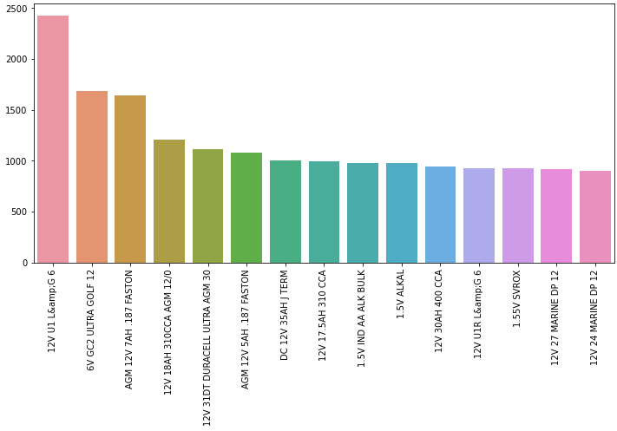
Top 15 products by unique purchases

Slide 4
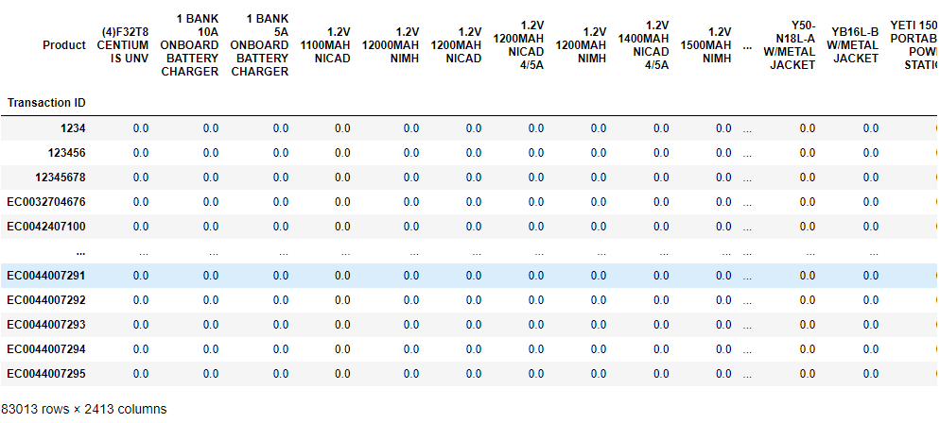
Creating Basket
Encoding:
Converting to 1 for unique quantity >=1
Converting to 0 for unique quantity <=0

Slide 5
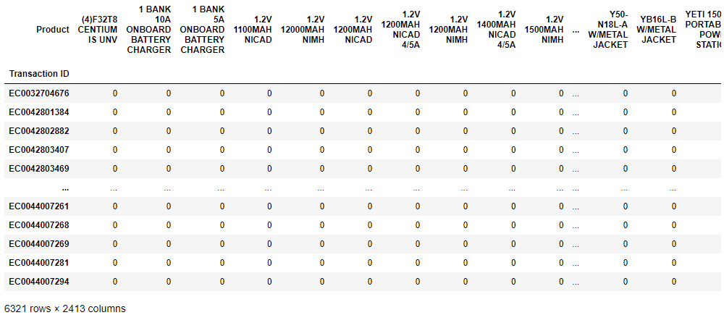
Creating Basket Contd.
Filtering The Transaction :
Bought More Than 1 Items Only
6321 transaction carrying bought more than 1 items
(6321 / 83013) * 100 = 7.61 % of the basket data is a transaction carrying bought more than 1 item.

Slide 6
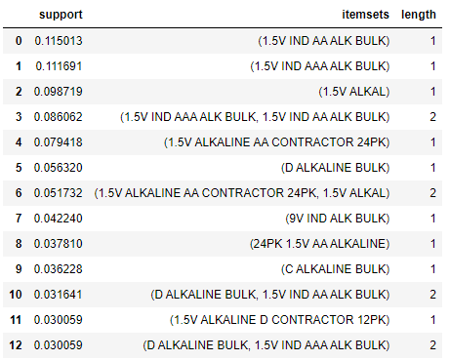
Frequently Bought Items
Apriori algorithm used to find the frequent item defined by the support 0.03
13 transaction considered as frequently bought items
1.5V IND AA ALK BULK –the most frequently bought items with the support value of 0.115013
The item bought = 6321 * .115013 = 727 times out of the whole transaction

Slide 7
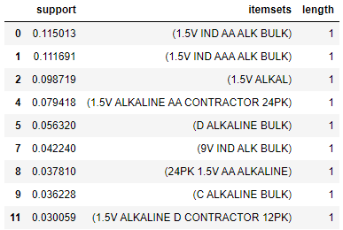
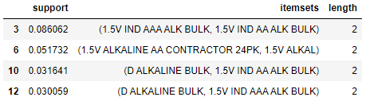
Frequently bought items 1 vs 2

Slide 8
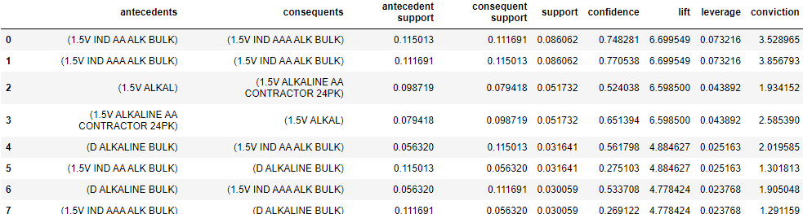
Association rules
1.5V IND AA ALK BULK and 1.5V IND AAA ALK BULK the items – carrying the highest association each other for the highest “lift” value
The highest lift value - 6.699549 which is very high.
These 2 items are very good to be sold together

Slide 9
Association rules Contd.
The support value of 1.5V IND AA ALK BULK and 1.5V IND AAA ALK BULK are 0.086062
8.60% out of total transaction that these 2 items were sold together.
In number, it is 6321 * 0.086062 = 544 times.
A customer will tends to bought 1.5V IND AAA ALK BULK, AFTER buying 1.5V IND AA ALK BULK

Slide 10
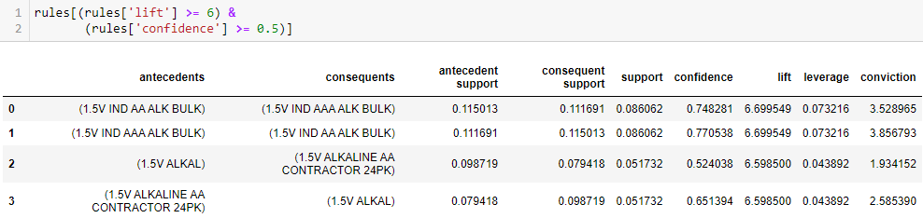
Most Strengthened Rules

Slide 11
Data-driven marketing strategy and decision making
Item Placements:
Keeping 1.5V IND AAA ALK BULK and 1.5V IND AA ALK BULK in a closer place, maybe in a same shelf or any other closer place
Products Bundling
Keeping 1.5V IND AAA ALK BULK and 1.5V IND AA ALK BULK as a single bundle of product with a lower price compare to each price combined -attracting more sales and generates more income
Customer Recommendation and Discounts:
Keeping 1.5V IND AAA ALK BULK in the cashier, so that every time a customer bought 1.5V IND AA ALK BULK, seller could offer and recommend them to buy 1.5V IND AAA ALK BULK with a lower price

Slide 12
Data-driven marketing strategy and decision making Contd.
Data-driven marketing strategy and decision making described in previous slide for items pair - 1.5V IND AA ALK BULK and 1.5V IND AAA ALK BULK can be applied for items pair to increase sales:
1.5V ALKAL and 1.5V ALKALINE AA CONTRACTOR 24PK

Slide 13
Increase sell of One Item through another Item
1.5V IND AA ALK BULK and 1.5V IND AAA ALK BULK
sold1022 quantity of 1.5V IND AA ALK BULK but only 806 quantity of 1.5V IND AAA ALK BULK
Driving more 1.5V IND AAA ALK BULK sales through recommendations
1.5V ALKAL and 1.5V ALKALINE AA CONTRACTOR 24PK
sold 1163 quantity of 1.5V ALKAL but only 715 quantity of 1.5V ALKALINE AA CONTRACTOR 24PK
Driving more 1.5V ALKALINE AA CONTRACTOR 24PK sales through recommendations

Slide 14
Thank You

